Slide 1
QGIS Space Syntax Toolkit Open Digital Works
Jorge Gil
Abhimanyu Acharya
Ioanna Kolovou
Laurens Versluis
Stephen Law
Space Syntax Limited
Open Digital Works
July 2017

Slide 2
Part 1 QGIS toolkit
1.1
Part 2 Open Digital Works
2.1 Background
2.2 Installation and Settings
2.3 Road network cleaner
2.4 Network segmenter
2.5 Space syntax analysis
2.5 Catchment analyser
2.6 Gate Transformer
2.7 Urban Data Input
2.8 Demonstration

Slide 3
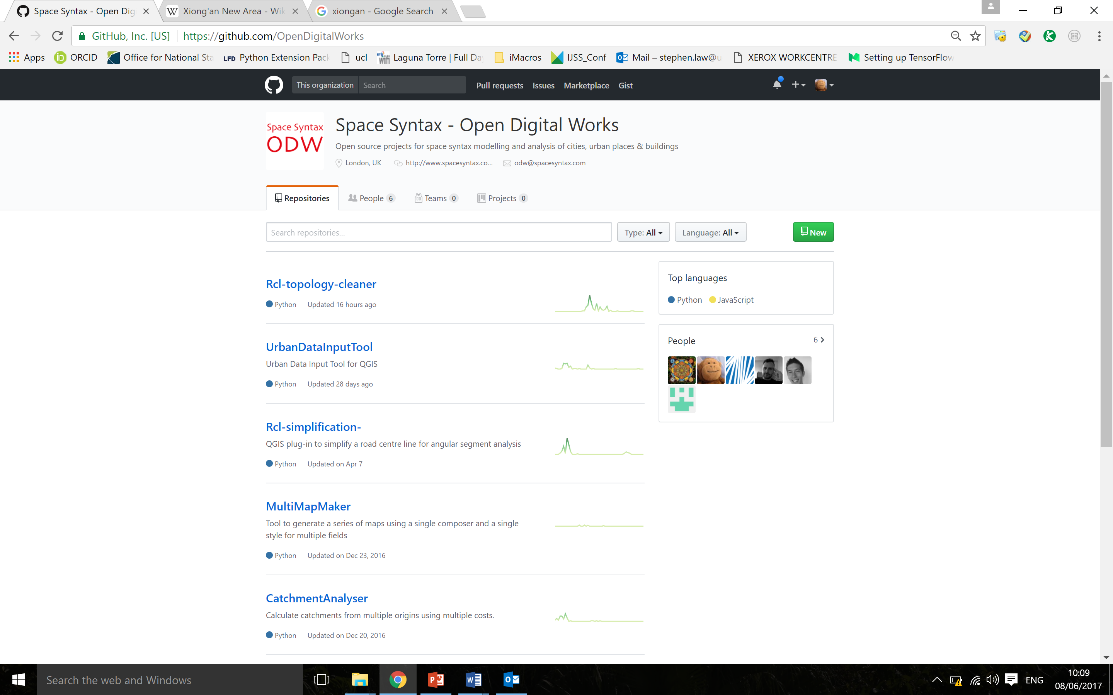
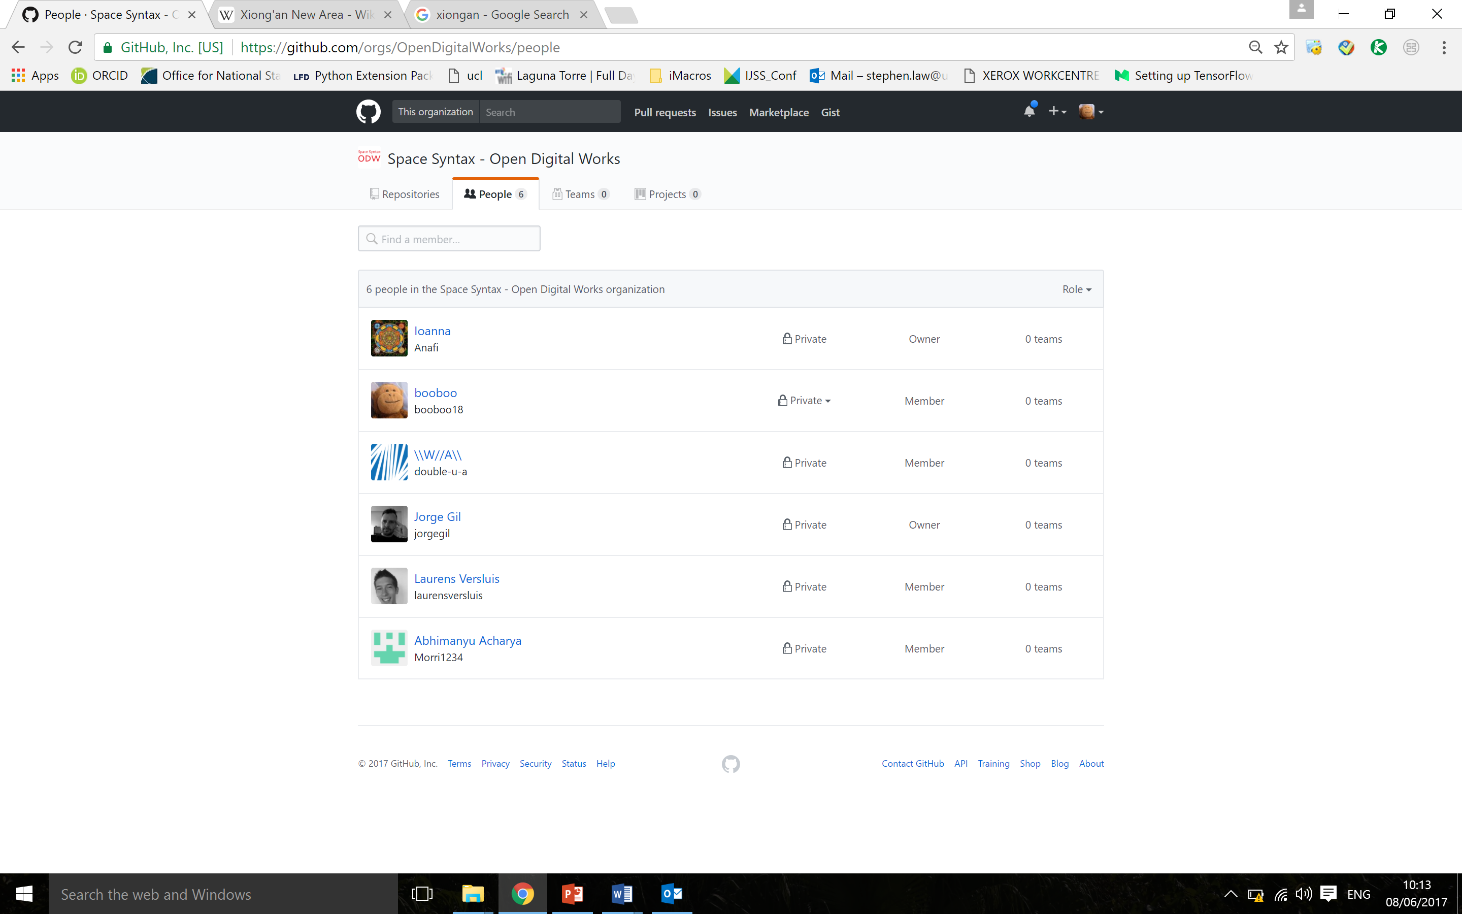
Background

Slide 4
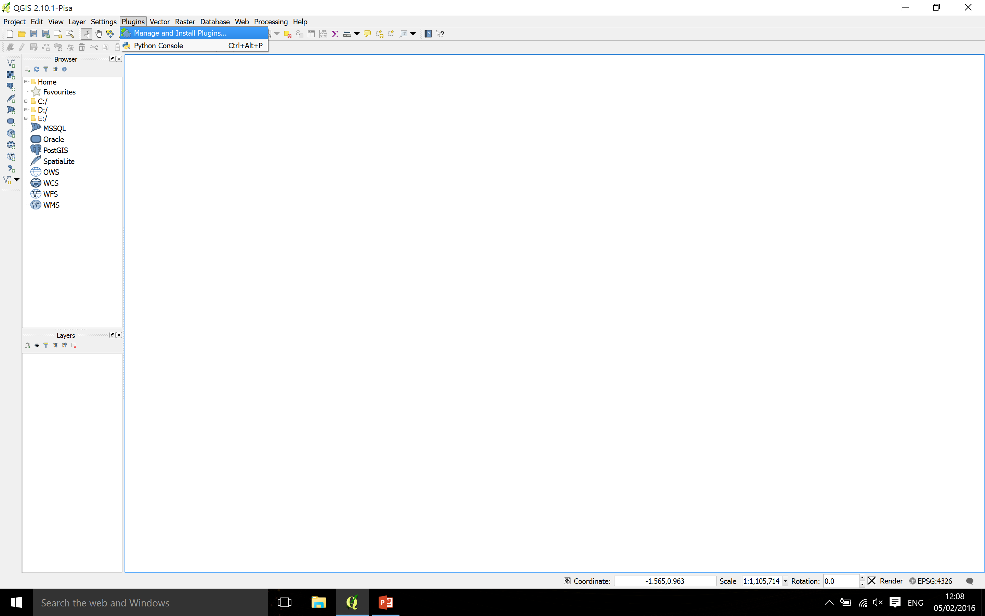
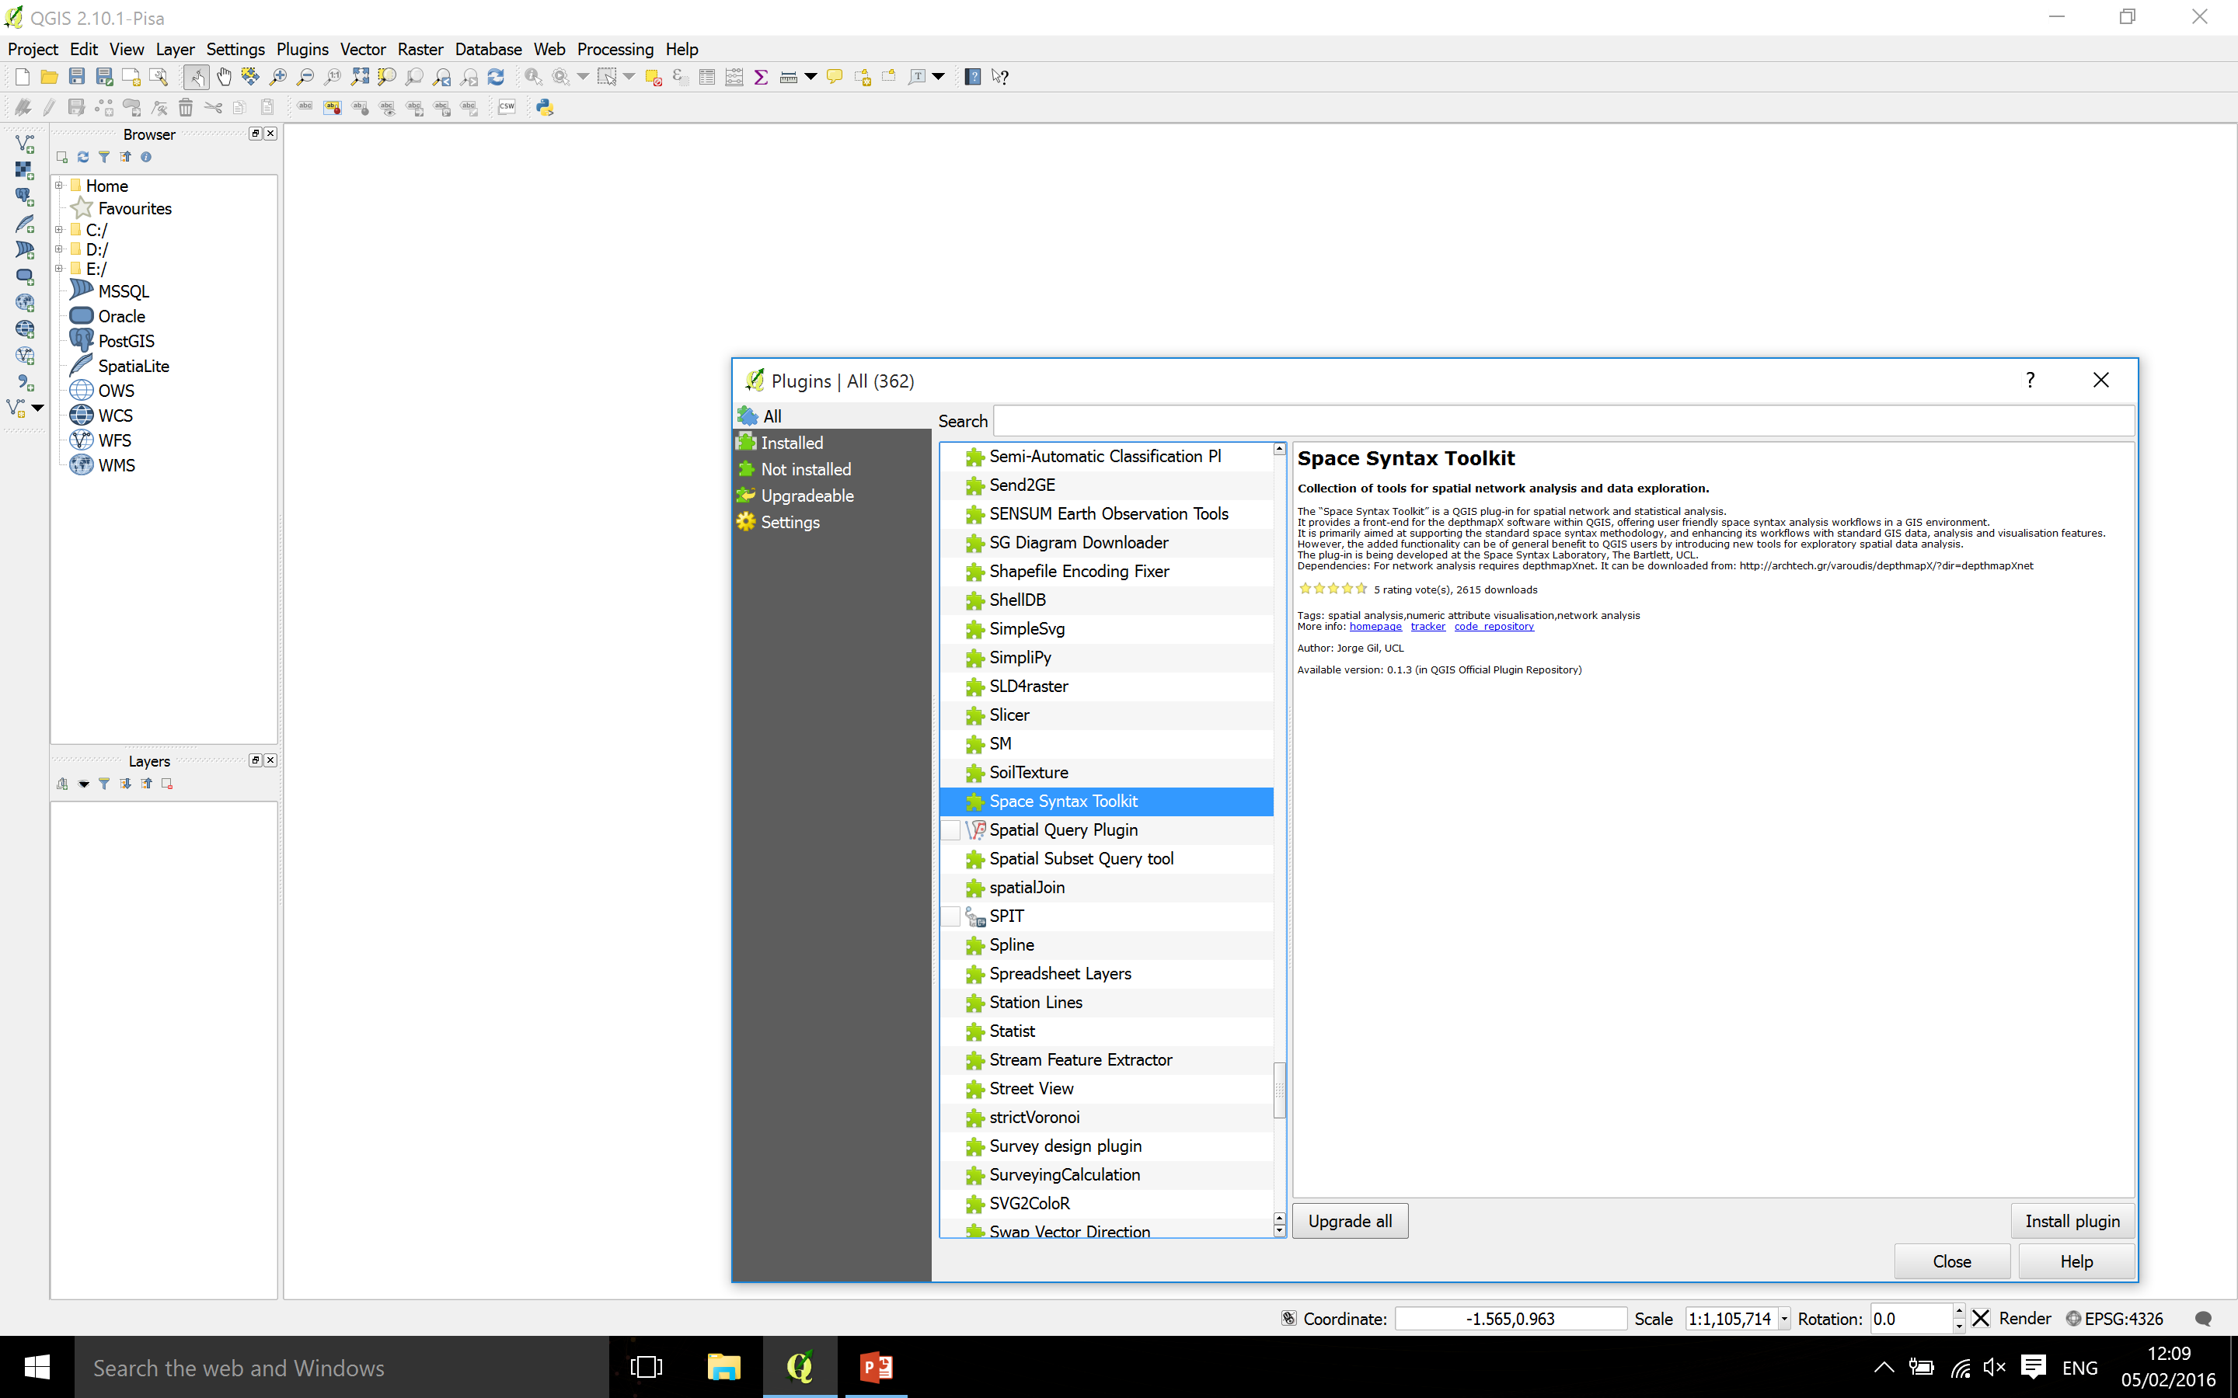
Installation and Settings

Slide 5
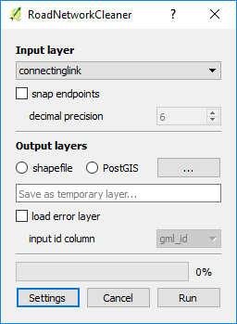
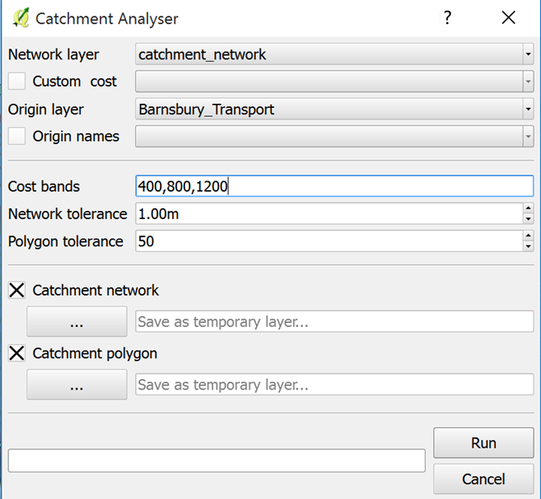
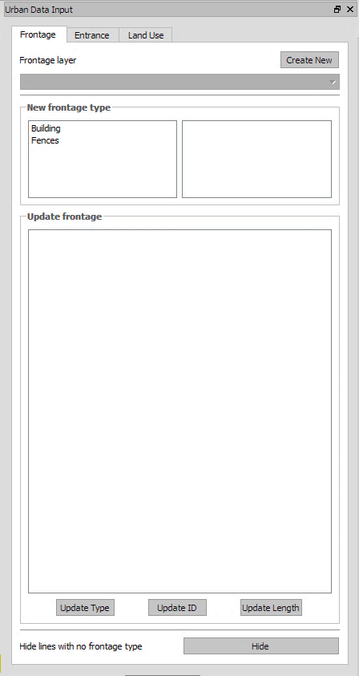
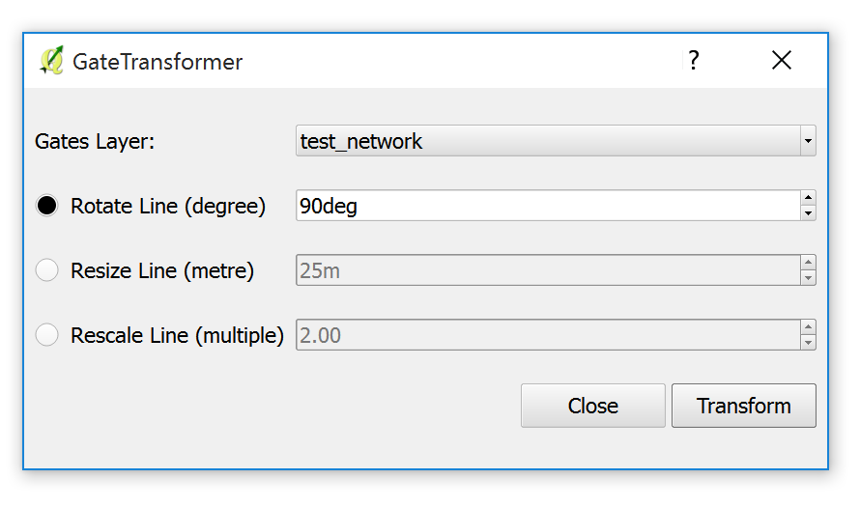
New Set of Plugins
Road network cleaner
Catchment Analyser
UrbanDataInput Tool
Gate Transformer

Slide 6
Demo Flowchart
RCL Topology Cleaning
QGIS Processing algorithm: simplify geometries
Network segmenter
Space Syntax Analysis
Catchment Analyser
Visualisation
Gate Transformer/movement correlation
Urban data input
Integrated Urban Model

Slide 7
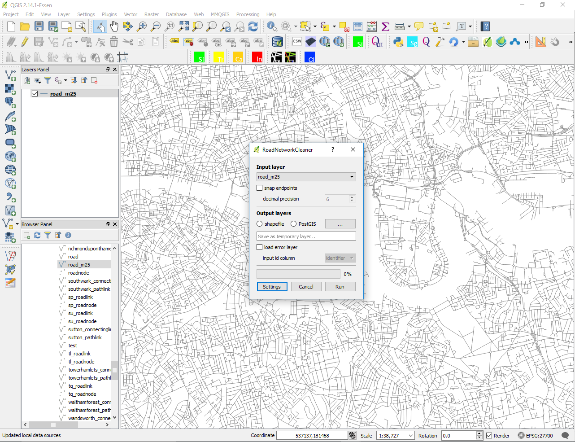
Road network cleaner
This plugin corrects topological errors of Road-centre-line (RCL) maps. This is a necessary step before performing space syntax analysis to any network.

Slide 8
Road network cleaner
Removes invalid geometries
Breaks self intersecting geometries
Breaks geometries at shared vertices
Removes point geometries
Removes duplicate and/or overlapping geometries
Merges lines between intersections
Breaks multi-part geometries
Removes closed polylines
Removes orphans (lines not connected to any other line)

Slide 9
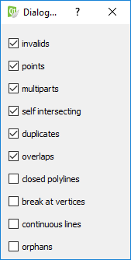
Road network cleaner
Input layer Choose RCL map to clean. The input can be any QGIS layer.
Snap endpoints The user can specify a decimal precision of the coordinates
Output layers The user can choose between a shapefile or a PostGIS database layer.
Load error layer The errors that have been corrected by the plugin can be loaded as a memory layer. If the user wishes to load the error layer, they must specify a unique id column. If there is no unique id column the user must create it prior to cleaning.
Settings Define which topological errors should be corrected.
Run Pressing run will perform the cleaning of the selected map
Cancel Pressing close will close and terminate the Road network cleaner

Slide 10
Network segmenter

Slide 11
Network segmenter

Slide 12
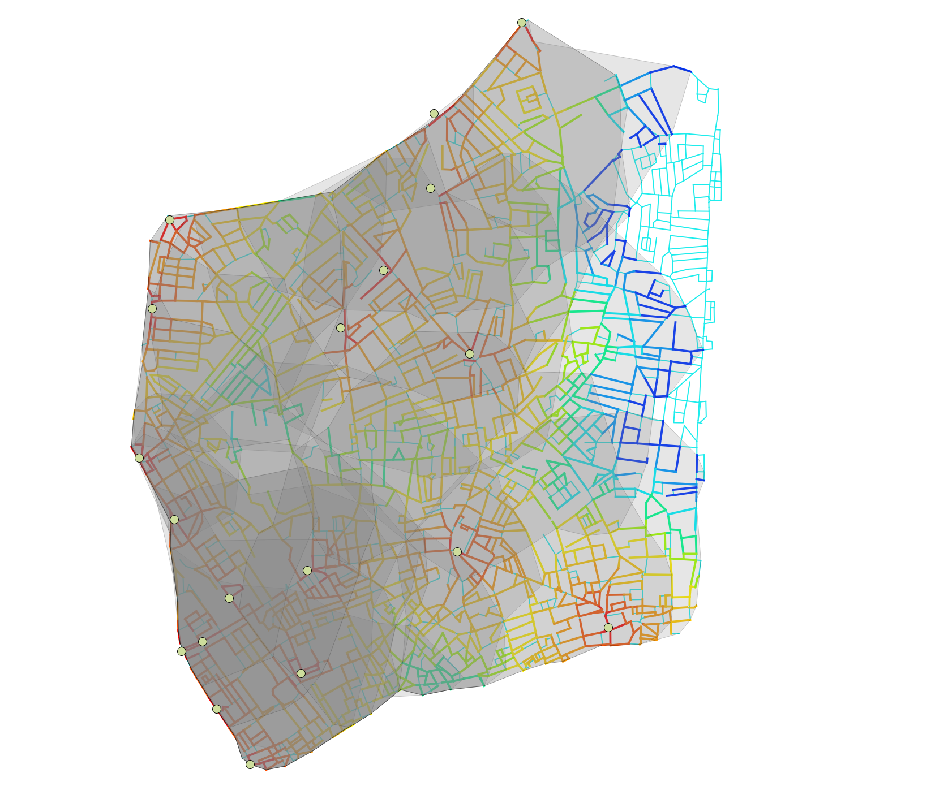
Catchment Analyser
This plugin takes a line-based network and point-based origin layer and calculated the distance from each segment within a given distance or list of distances to each of the origins. The tool outputs the catchment as lines and as a concave hull polygon layer. Credit for the concave hull functionality goes to the algorithm described by Adriano Moreira and Maribel Yasmina Santos.

Slide 13
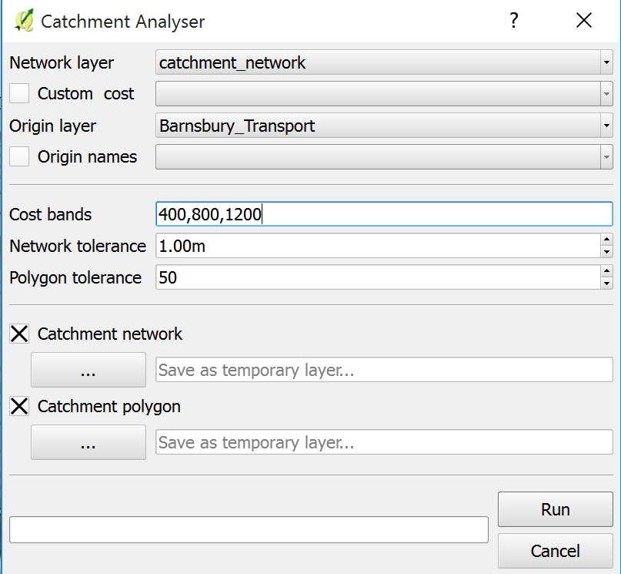
Catchment Analyser
Network layer Choose the line-based vector layer that comprises a topological network you want to analyse. (projected CRS only!!)
Custom cost By default the tool will generate catchments based on the length of the network segments. If checked the tool will apply a weight based on the column selected.
Origin layer Choose the point-based vector layer containing the origins from which catchment will be calculated.
Origin Names By default the origin names will be based on the feature ids. If checked the tool will run the catchment analysis based on the column selected.
Cost Bands This sets the radius for the catchment analysis. For example, 400,800,1200,2000.
Network tolerance This is a tolerance for disconnected network. For example, it will connect lines that are within 1m by default.
Polygon tolerance The Catchment Analyser tool creates concave hull polygons from a specific origin. The polygon tolerance defines the level of 'concaveness' of the catchment. The lower the value, the more concave and the higher the value the more convex.
Catchment network The tool provides a catchment network output based on the original network layer with cost information on every origin. If checked the tool will generate the network as a temporary layer or as a shapefile using the browse button.
Catchment polygon The tool provides a catchment polygon output for each origin and each specified cost. If checked the tool will generate the polygons as a temporary layer or as a shapefile using the browse button.

Slide 14
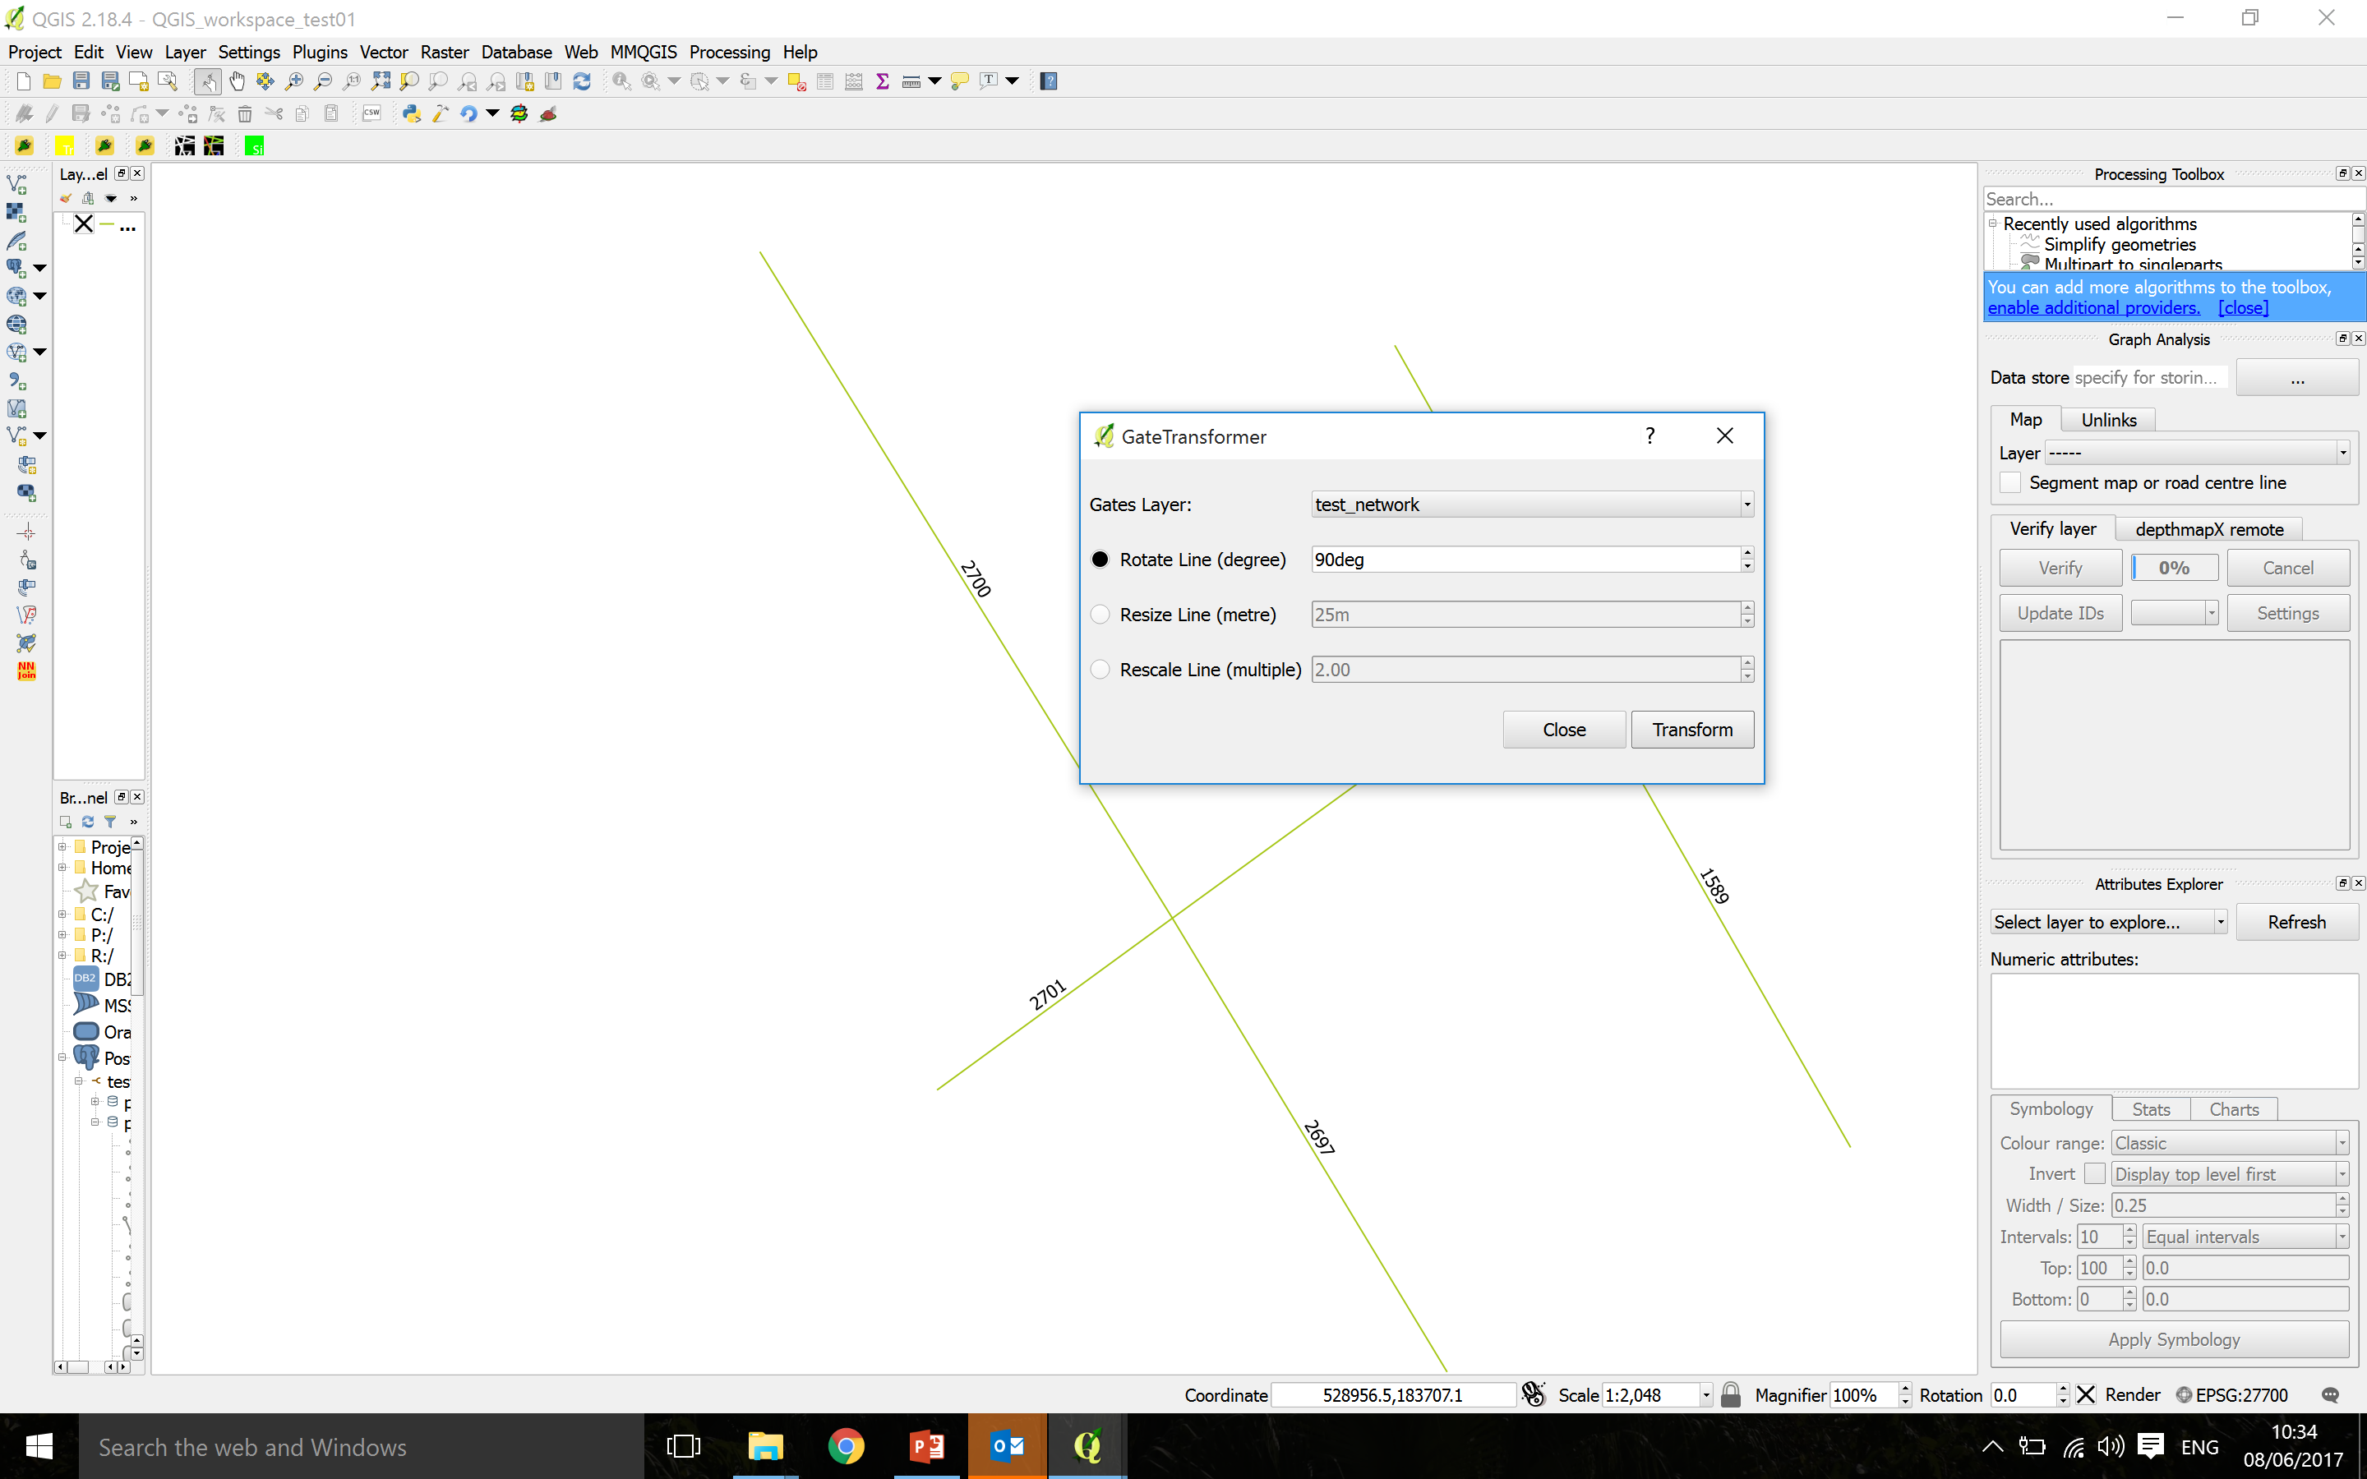
Gate Transformer
Gate Transformer is a plugin to modify the geometry of gates used in space syntax movement observations. Gates are usually drawn perpendicular to the axial line, with varying lengths. For presentation of movement observations the typical output is a map showing lines along the axial lines to indicate the movement direction. The gates should all be rotated 90degrees and have the same length.

Slide 15

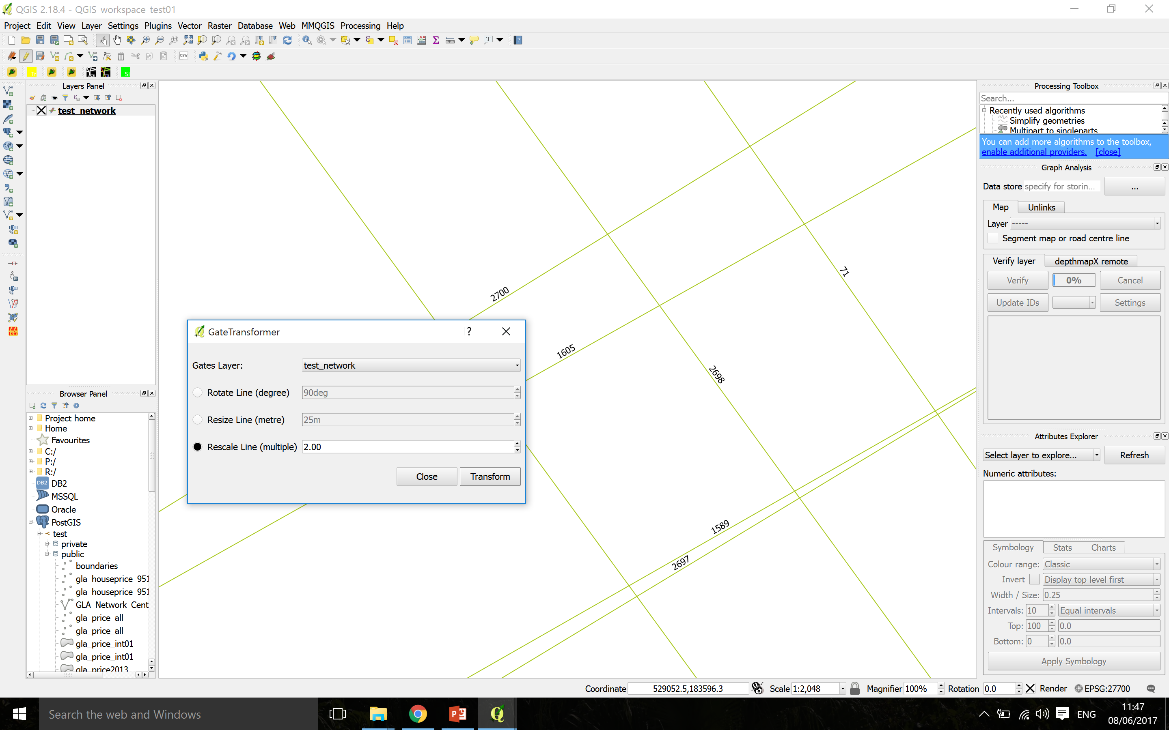
Gate Transformer
Gates layer Choose the line-based gate layer from the drop-down menu that you want to transform
Rotate Line (degree) Define the angle in degrees for rotating the selected gates
Resize Line (metre) Define the length in metres for resizing the selected gates
Rescale Line (multiple) Define the multiple in ratio for rescaling the selected gates
Transform Pressing the transform button will activate the analysis for the selected transformation
Close Pressing close will close and terminate the Gate Transformer
Rotate Line
Resize Line
Rescale Line

Slide 16
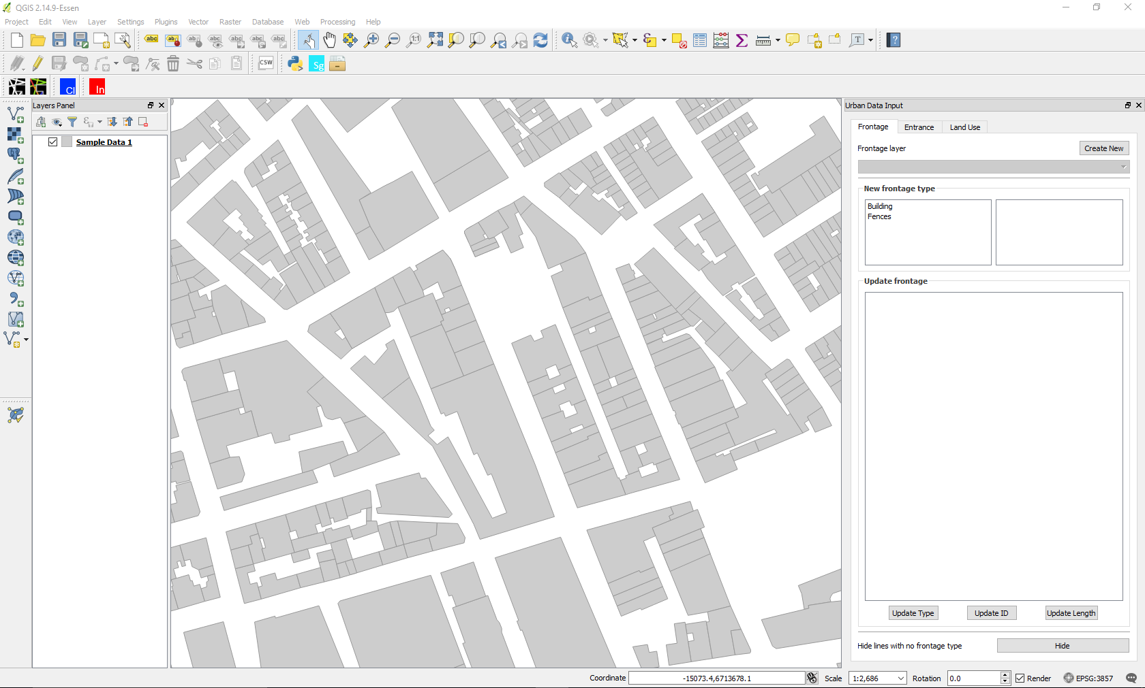
Urban Data Input Tool
Urban Data Input Tool is a plugin to ease aid the input of urban data like frontage type, entrance type and land use type as per Space Syntax Limited standards. The Space Syntax community is the key users for the plugin. The display styles and categories included are as per Space Syntax Limited Standards. The default display style but can be changed by editing the .qml file in the plugin folder.

Slide 17
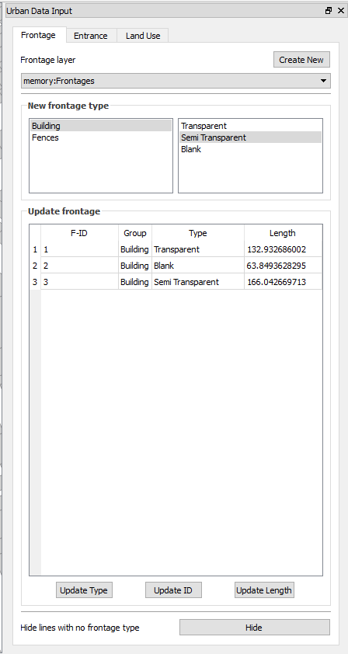
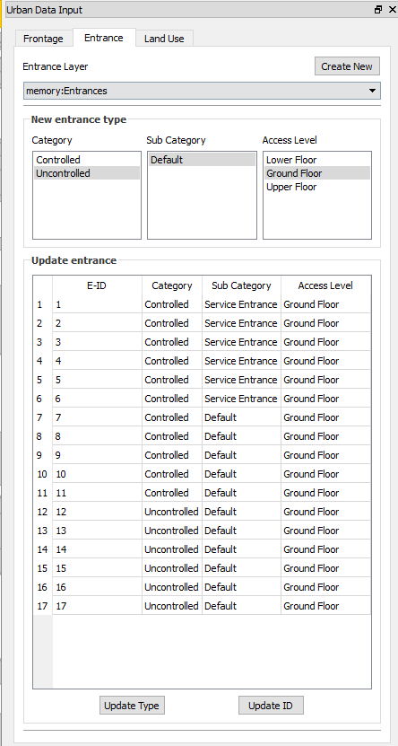
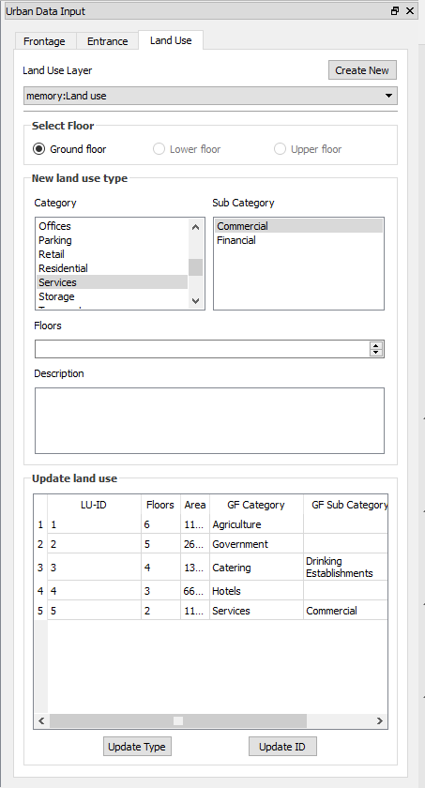
Urban Data Input Tool
Frontage tool
Entrance tool
Land use tool

Slide 18
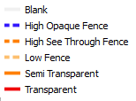
Urban Data Input Tool Frontage tool
Data categories
Create New Frontage layer
Using buildings/block dataset
Without using building/block dataset
Frontage Category
Selected feature data
Update buttons
Hide lines with no data

Slide 19
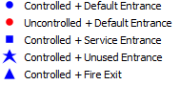
Urban Data Input Tool Entrance tool
Data categories
Create New Entrance layer
Entrance Category
Selected feature data
Update buttons

Slide 20
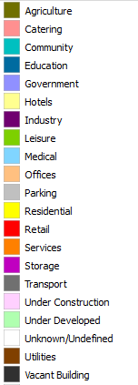
Urban Data Input Tool Land use tool
Data categories
Create New Land use layer
Land use Category
Building data/ description
Selected feature data
Update buttons

